Slide 1
Empowerment
Authority and Power

Slide 2
AUTHORITY
Authority gives a person the right to make decisions in a particular situation.
Why do we need to have some people in authority?
What do you think would happen if we did not?
given
legal

Slide 3
POWER
When people are in authority, they have the power to affect the lives of others.
fair/unfair
constitution
human rights laws

Slide 5
PERSONAL EMPOWERMENT
As you get older, the law will give you the authority to have more and more power over your own life.

Slide 7
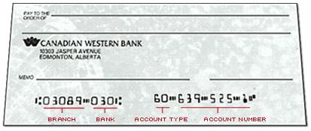
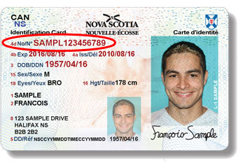
Legal Milestones in Growing Up
power?
responsibilities?

Slide 8
PERSONAL EMPOWERMENT
Personal empowerment comes from having the ability to do something about YOUR needs, wants, opinions, beliefs and feelings.
independence
contributions

Slide 9
Learn all you can learn.
Volunteer
Know where to go for help.
Work
Be proud of your heritage.
Know your rights and responsibilities
Make friends.

