Slide 1
Economic Security
Chapter 3 of Changing your World

Slide 2
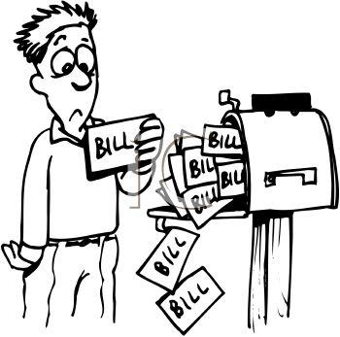
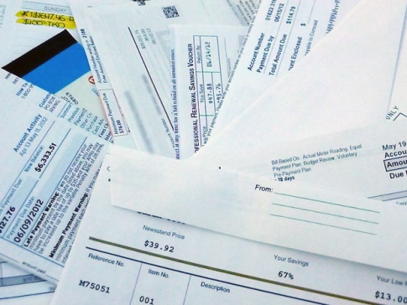
What is Economic Security?
Economic Security is when an individual has a stable income that allows them to maintain their current standard of living and that of the near future.
This means that you are able to pay your bills (mortgage, car, cable, phone, insurance...) as well as buy food, pay membership fees (YMCA, Goodlife...), clothes...etc

Slide 3
Factors that can affect Economic Security
There are many factors that can influence a person's ability to maintain their standard of living some of which could be:
A new job
Loss of employment (company shutdown)
Illness, Injury or Dead in the family
Addiction (alcohol, gambling, drug...)
Poor returns on investments

Slide 4
Canada’s Economy
In the last chapter we learned that European economies were based around the ideas that:
1) Goods and service are distributed through buying and selling
2) Individuals should be free to become as wealthy as they can.
Economists call this kind of economy, which we have in Canada today, is called Capitalism.
Canada may be based on Capitalism, but there are government programs in place to make sure everyone has access (schooling, medical treatment...)

Slide 5
Capitalism vs. Socialism
Capitalism | Socialism
Individual freedom is highly valued | What is best for the group is more important than individual freedom
Production of goods and services is in the hands of the individuals | Production of goods and services is in the hands of the government
Whether or not people can meet their needs depends on how wealthy they are | Every person should receive enough to meet his or her needs
Competition is important to help create wealth and improve society | Co-operation is important to help create wealth and improve society

Slide 6
Capitalism vs Socialism

Slide 7
CAPITALISM
wage labour
private ownership of industry
freedom of competition (profit for some)
results in unequal economic classes

Slide 8
SOCIALISM
everyone works for wealth, that is distributed evenly
government ownership of industry
goal is to bring economic equality
aims for a classless society
higher taxes = free education, free health care, etc.

Slide 9
Capitalism
The term capitalism comes from the word capital, and capital is the money or items of value one has access to (home, car, cottage or land, collectibles, jewelry...)
With respect to business capital is used to start up and maintain a business, while profit is the money paid back after expenses [bills (heat, insurance, benefits, etc), wages, materials, suppliers, shipping...)

Slide 10
Understanding Poverty
About nine per cent of Canadians live in poverty, although the percentage is generally higher among certain groups such as single mothers and Aboriginal people. Low-income Canadians include the "working poor" — those with jobs — and the "welfare poor" — those relying mainly on government assistance.
(Canadian Encyclopedia, 2014)
Poverty or living with poverty is when people have trouble meeting their basic needs and rarely have a chance to get the special things that they want.

Slide 11
Understanding Poverty continued...
Standard of living can be thought of as a persons “buying power”. This includes everything that can be bought with money – home, food, entertainment, transportation, and so on.
In this way of thinking a person or family is with poverty when they have a lower standard of living than most people around them.

Slide 12
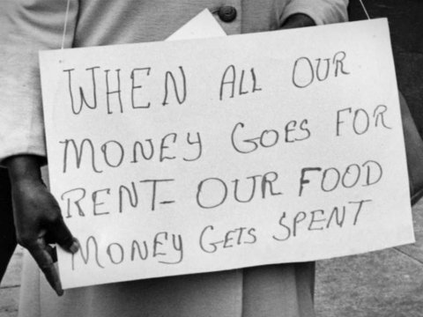
Another way to define poverty is to calculate whether or not you can survive on the money you make. In this case, if basic needs are higher than income they are living with poverty.

Slide 13
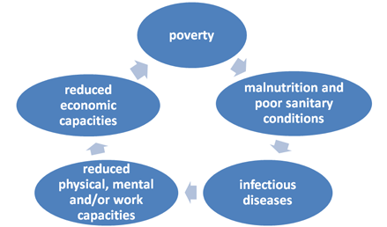
Poverty Cycles
People living with poverty often have problems because that can’t afford healthy food, regular dental care, and warm clothes. If you are not healthy, it is hard to work. If you can’t work, you can’t earn a living.

Slide 14
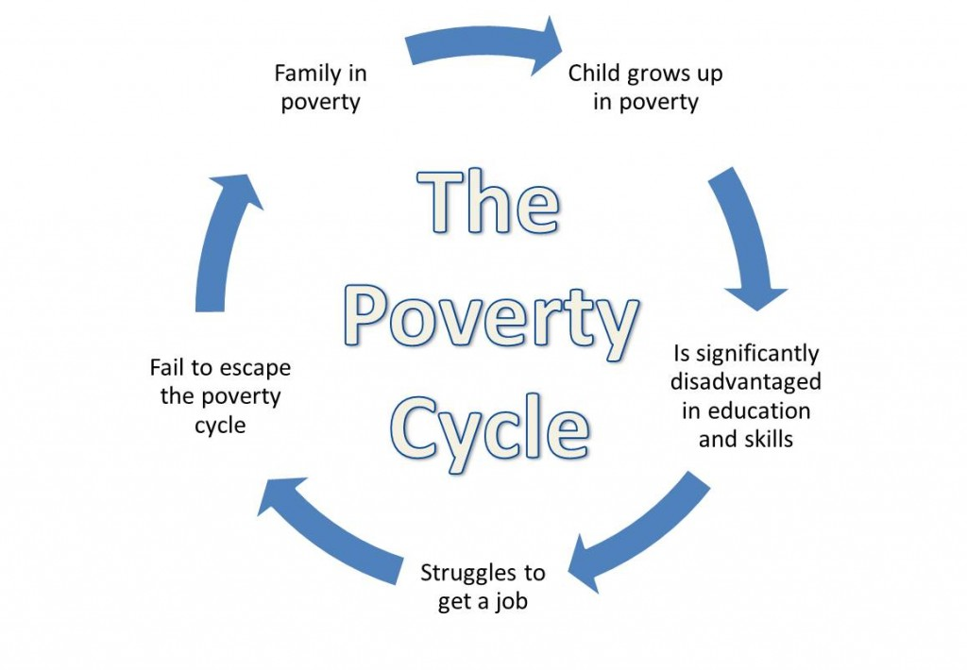
Poverty Cycles
People living with poverty might not be able to afford the things they need in order to look for work. For example, if you don’t have a car or can’t afford to take the bus, you might not be able to get to job interviews.

Slide 15
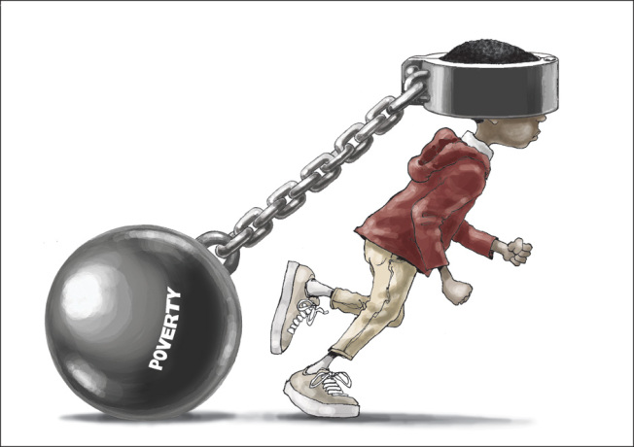
Poverty through the Generations

Slide 16
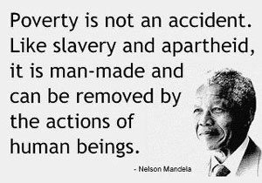
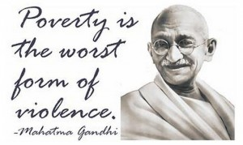
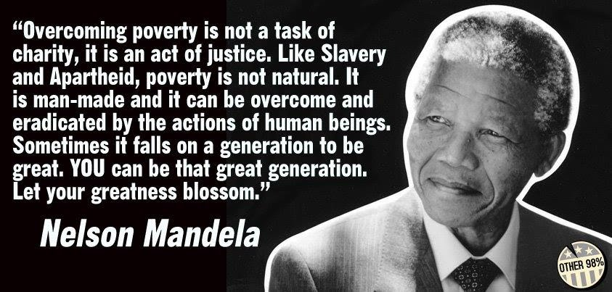

Slide 17
Breaking the Poverty Cycle!
There are a number of organizations and programs available to people living with poverty to help them break the cycle. Below are a few examples, as a class come up with as many as you can:
Social Services: subsidized daycare, counseling, and child welfare
Unemployment Insurance
Family Allowance
...

Slide 18
Breaking the Poverty Cycle!
People who are caught in the poverty cycle have little chance to increase their personal capital. Banks won’t give loans, or credit cards and it is hard to save money with large bills like rent.
But people do break the cycle and one way is to get training or further education to improve jobs skills. Although this costs money there are programs to help.

Slide 19
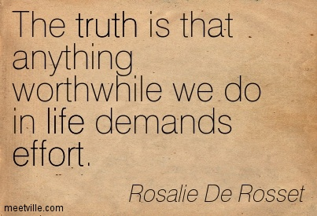
Building Capital
Personal capital includes anything you have that can help improve your economic situation. For the most part this includes things that have a high value; savings, property, vehicles,... It can also include skills or a willingness to work hard.
Anything worth doing is worth doing right!

