Slide 1
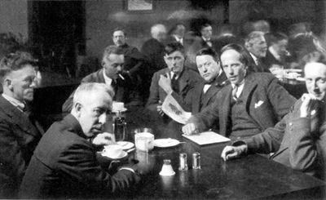
The Group of Seven

Slide 2
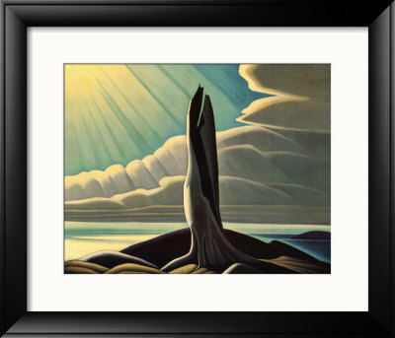
What is so cool about the Group of Seven?
They were all Canadian
Artists that painting
places in Canada
Wanted to develop an
artistic style they
can call “Canadian”
There were 7 members!
Notes:
The story of the Group of Seven Artists began in the early 1900s when several Canadian Artists began noticing a similarity in style.
They were all friends who believed that the true spirit of Canada could be found in its northern landscape. It was the
turn of another century, around 1911, when the group began sketching and painting together. Canadian art at that time
was greatly influenced by European tradition. Canadian artists that ran afoul of tradition were largely overlooked by
the critics and found little, or no, market for their paintings.

Slide 3
And the Group Members are……
Notes:
Their names were Franklin Carmichael, Lawren Harris, Alexander Young Jackson, Frank Johnston, Arthur Lismer, J.E.H. MacDonald
and Frederick Varley
With the exception of Lawren Harris who came from a wealthy background and did not need to be gainfully employed, they were, in the beginning, all commercial artists who in their spare time enjoyed painting.

Slide 4
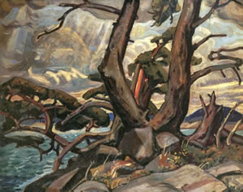
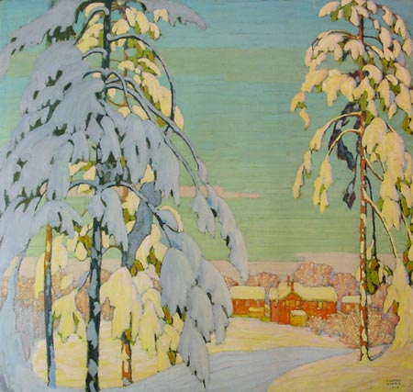
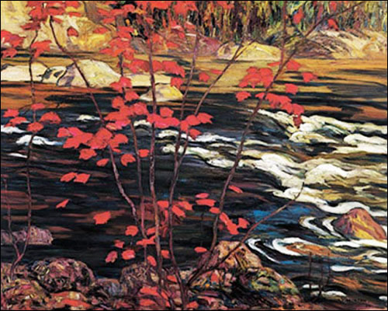
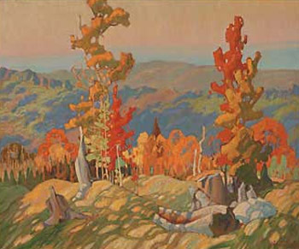
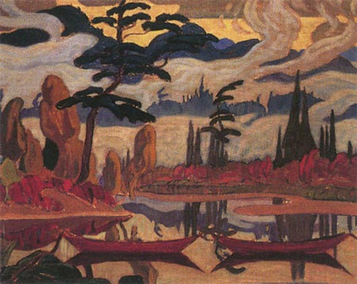
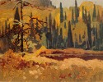
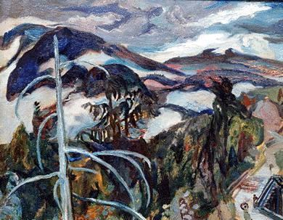
Arthur Lismer
Lawren Harris
A.Y Jackson
Franklin
Carmichael
J.E.H. Macdonald
Frederick Varley
Frank
Johnston
Notes:
These are the 7 members. Students should write them down. We will talk about them in depth in the next few slides.
QUESTION TO THE CLASS: Do you see how all 7 paintings look similar? Name/ List some things you see that are in all the paintings..
-subject matter, trees, outside, water, landscape, view point, seems like they are painting from what they see.
-colours, natural, bright,
-thick paint, texture, attention to detail, shapes, areas of colour, blending, chunky, very specific placement

Slide 5
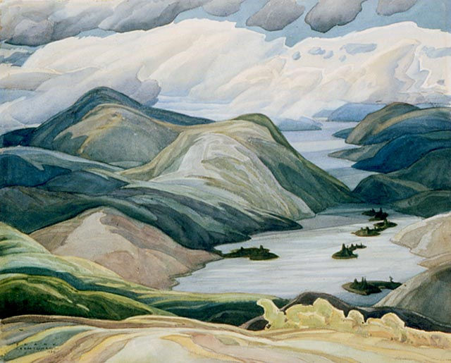
Franklin Carmichael
Grace Lake
1933

Slide 6
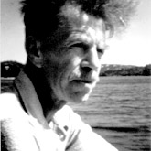
Franklin Carmichael
1890-1945
The youngest member of the Group of Seven, was born in Orillia Ontario in 1890.
He left Orillia in 1911 and moved to Toronto to pursue an interest in art.
As a member of the Group of Seven, his greatest contribution was in reviving the neglected art of watercolour painting.
Carmichael discovered the La Cloche Hills in 1926. He was so taken by the landscape that he spent much of the rest of his career as an artist painting and sketching in the La Cloche Hills.
Carmichael favoured a panoramic view from the top of the hills, places that matched his interest with space and distance such as seen in Grace Lake.
In 1934, he built a cabin at Cranberry Lake where he vacationed and painted each year until his death in 1945

Slide 7
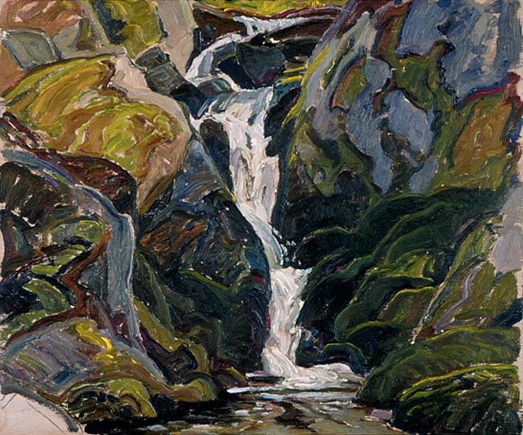
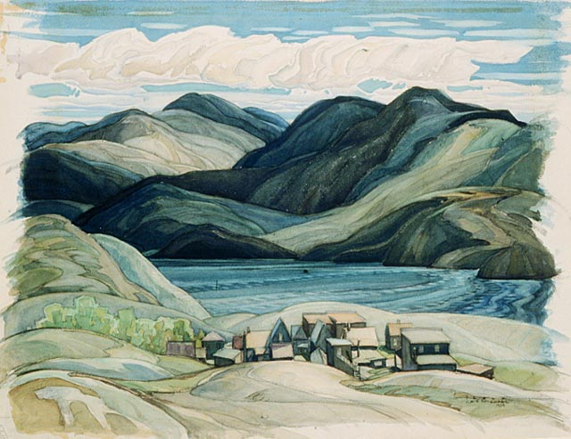
Franklin Carmichael
Waterfalls on the way to Nellie Lake
1939
Cranberry Lake
1934

Slide 8
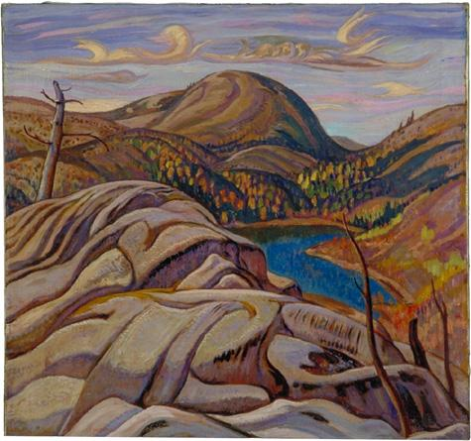
A. Y. Jackson
Nellie Lake (Ontario)
1933

Slide 9
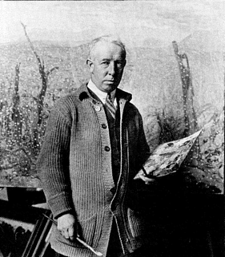
Y. Jackson
1882- 1974
A.Y. Jackson was born in Montreal in 1882.
He left school at the age of 12 and began working in a printing firm. 1907 he undertook studies in Art in France.
In 1913 Lawren Harris and J.E.H MacDonald impressed by his work invited him to move to Toronto.
In 1915 Jackson was the only member to join the army and was sent to Europe when the war broke out.
Upon being wounded and returning home to Canada, Jackson would spend the rest of his life painting and sketching across Canada from Georgian Bay and even as far north as the Canadian Arctic. He would continue this active lifestyle well into his eighties.
Notes:
Alexander Young Jackson was the bachelor and Explorer-naturalist of the Group of Seven. Proficient in the use of the canoe and an able outdoors person Jackson traveled across Canada sketching and painting the northern landscape
A founding member of the Group of Seven, Jackson work and personality were immensely popular. He was very much a romantic whose main concern was to reveal Canada to Canadians.

Slide 10
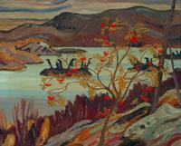
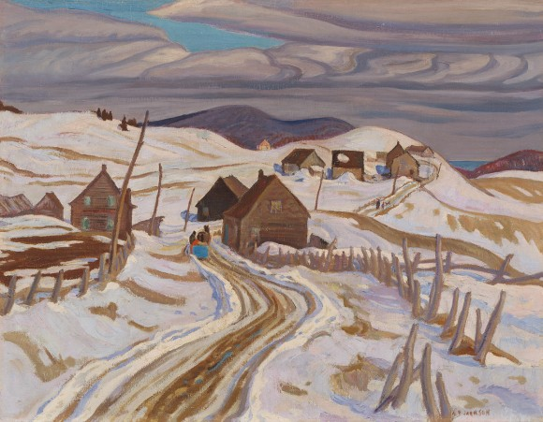
Y. Jackson
Grace Lake
1940
The Road to St. Fidele
1929-1930

Slide 11
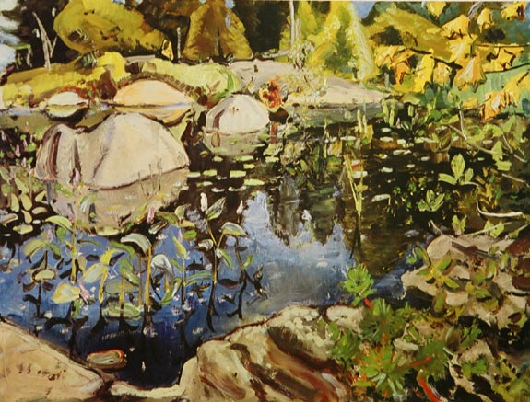
Arthur Lismer
Lily Pond Georgian Bay
1948

Slide 12
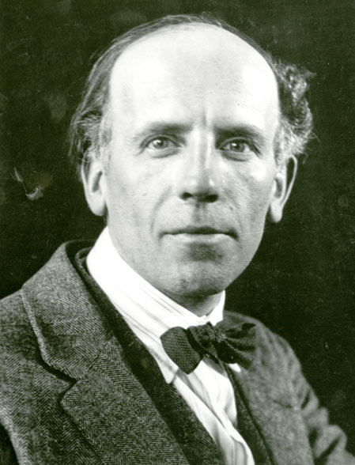
Arthur Lismer
1885- 1969
Arthur Lismer emigrated from Sheffield England in 1911 and gained employment at the Toronto commercial design firm, Grip Ltd. Here he met other future members of the Group of Seven.
Although he continued to paint throughout his lifetime, Lismer had a strong commitment to teaching while working at the Art Gallery of Ontario, he established one of the most successful children's art
Programs in South Africa.
Lismer was an active promoter of the Group of Seven and the author of many articles on Canadian Art.
Lismer is best known as the Group of Seven’s painter of Georgian Bay. His oil sketches, pen and ink sketches and paintings of Georgian Bay’s vegetation and pine covered, windswept, islands are judged to be the richest part of his life’s work.
Notes:
--Lismer’s consuming interest in texture and in nature caused Lismer to return with his family summer after
Summer to McGregor Bay to seach out the lichen patterened rocks and tangled undergrowth
--Lismer is said to be a brilliant and happy man, the eternal optimist, who justified faith in life through his long career of giving and sharing. Through his paintings we continue to share his happiness and love of nature.

Slide 13
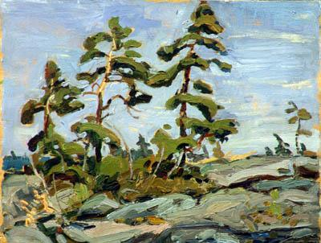
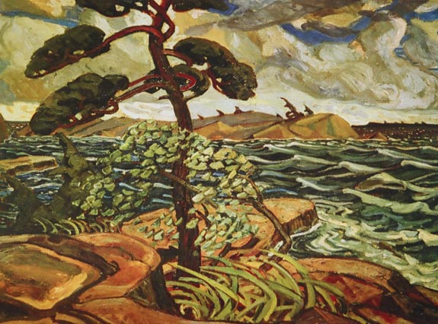
Arthur Lismer
Pine against the Sky
1933
A September Gale
1938

Slide 14
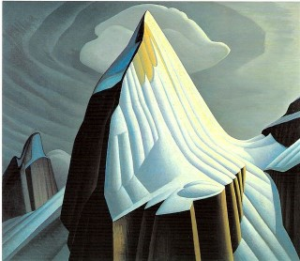
Lawren Harris
Mount Lefroy
1925

Slide 15
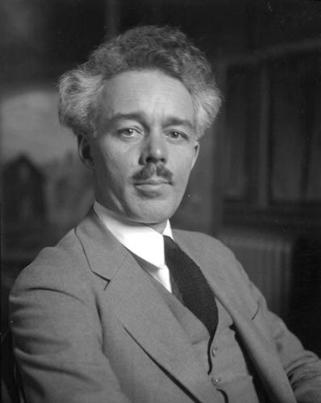
Lawren Harris
1885-1970
Lawren Harris was born on October 23, 1885, in Brantford, Ontario, to a wealthy family
The Harrises of the Massey-Harris industrial fortune.
He took up painting at an early age and studied in Germany from 1904 to 1907.
Harris was in fact the only member of the Group of Seven who was free all his life from monetary pressures and temptations of commercial art and advertising designs.
Harris is also the only member of the Group who kept pushing his painting, never resting for long with one style or one species of subject matter.
It was Harris who led the way toward painting the high Arctic, the Rocky Mountains, Gaspe and other unique and powerful parts of the Canadian earth
Notes:
Long after the Group disbanded, Harris continued to grow and change as a painter, moving eventually into art deco and pure abstraction. He was also a talented ceramicist, and in 1922 he published a volume of poems.

Slide 16
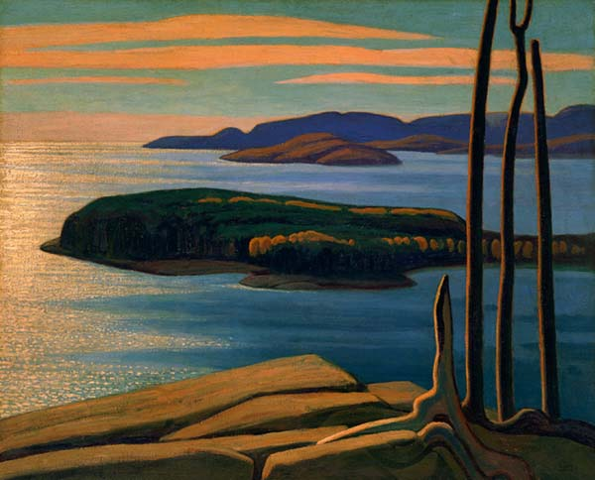
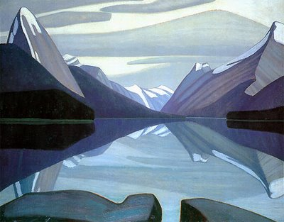
Lawren Harris
Afternoon sun Lake Superior
1922
Maligne Lake Jasper Park
1924

Slide 17
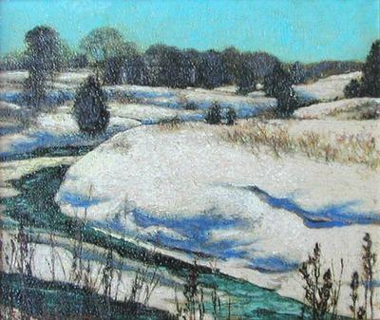
Frank Johnston
Winter at Wyebridge
1930

Slide 18
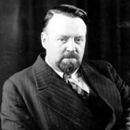
Frank Johnston
1888-1949
Frank Johnston was born in Toronto
and like many other Group members, he joined
Grip Ltd. as a commercial artist.
Johnston painted very much differently than the others.
Johnston chose close-up views that often seemed crowded.
Other works showed more simple landscapes,
with subtleties like clouds reflecting on water.
Although an original member of the Group, Johnston's association was a brief one. He did exhibit in the exhibition of 1920, but by 1921 he had left Toronto to become Principal at the Winnipeg School of Art.
Notes:
His paintings from those years express a strong decorative interpretation of the landscape. In later years, the artist's style became more realistic and revealed a strong fascination with the qualities of light

Slide 19
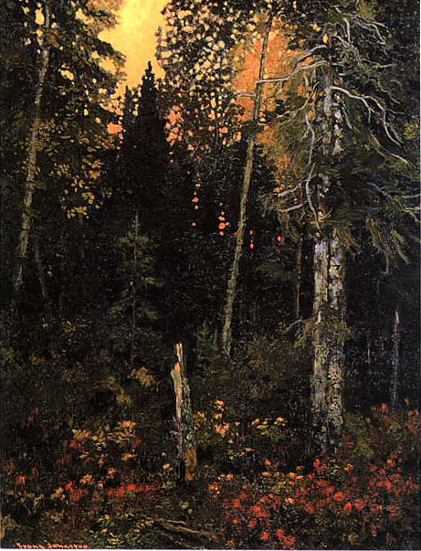
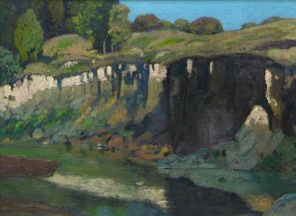
Frank Johnston
Haliburton River
1918
Sunset in the Bush
1918

Slide 20
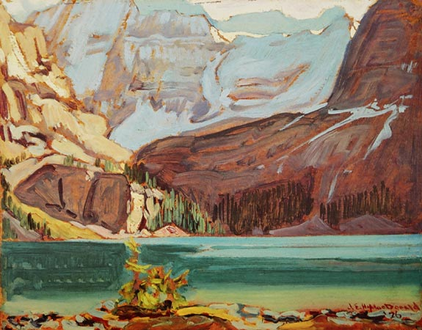
J.E.H. MacDonald
Lake O'Hara Rocky Mountains
1926

Slide 21
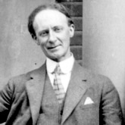
J.E.H. MacDonald
1873-1932
MacDonald was born in Durham, England
and moved to Canada at the age of fourteen.
He trained as an artist in Hamilton and Toronto, pursuing a career in commercial art
In 1895 he joined the Grip Engraving Company in Toronto where he met and encouraged other staff members, including Tom Thomson, Frank Carmichael, Arthur Lismer and Fred Varley, to paint with him on weekends - laying the groundwork for what would later become Canada's famous Group of Seven.
A founding member of the Group of Seven, J.E.H. MacDonald challenged and vastly broadened the scope of Canadian Art.
MacDonald believed that art should express the "mood and character and spirit of the country", and he portrayed his vision in vast panoramas using dark, rich colours and a turbulent patterned style.

Slide 22
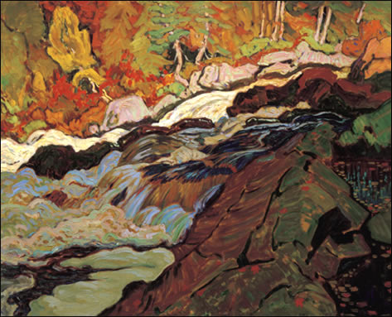
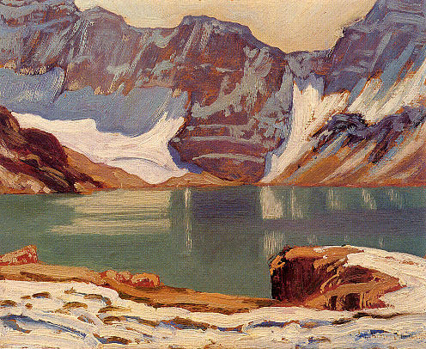
J.E.H. MacDonald
Batchawana Rapids Algoma
Lake McArthur
1924

Slide 23
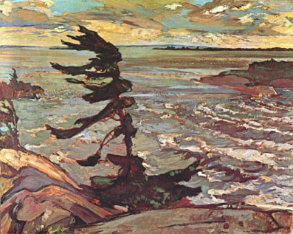
Frederick Varley
Stormy Weather
1920

Slide 24
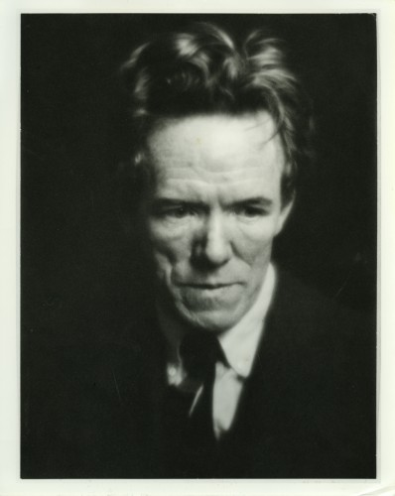
Frederick Varley
1881-1969
Frederick Varley was born in 1881 in England.
He studied painting at and went to work in London as a commercial illustrator.
In 1912 he came to Canada, where he found himself
working in the same commercial studio as Tom Thomson.
With Thomson and the others he took to painting Northern Ontario landscapes, and also began to do considerable work as a portrait painter.
In 1933 he founded his own school, the AB College of Arts in Vancouver, but this venture led to his bankruptcy in 1935. In 1938 his marriage also collapsed.
The next years were difficult for Varley, most of them spent suffering from alcoholism in Montreal. In 1945, however, he returned to Toronto and slowly began to work again. He died in Toronto in 1969.

Slide 25
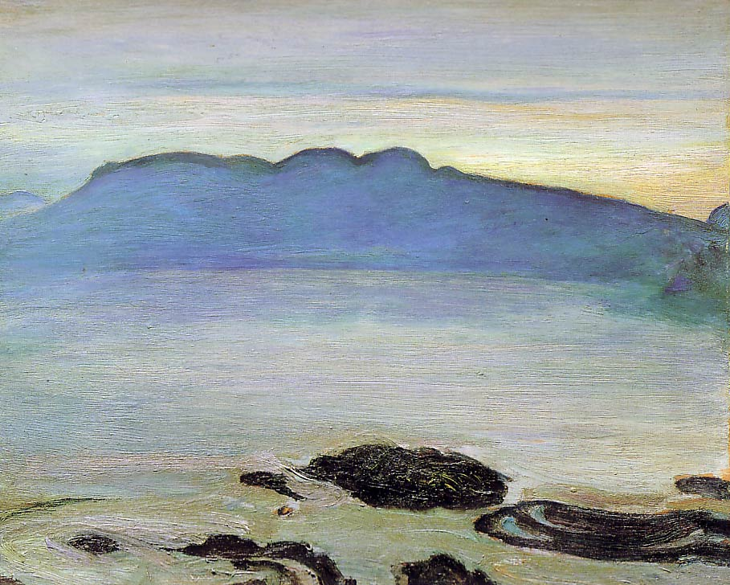
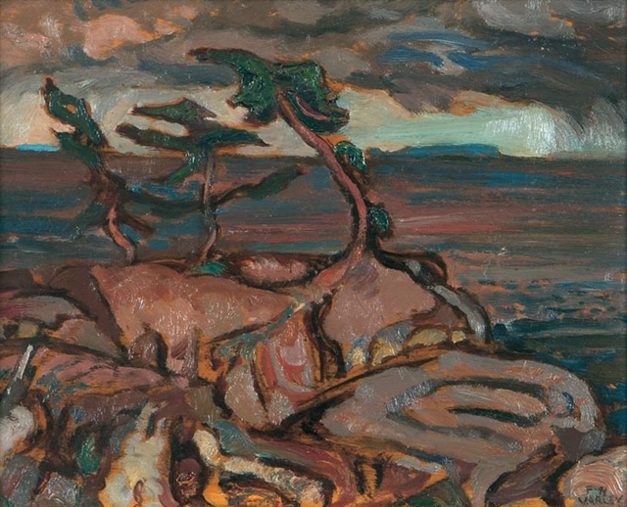
Frederick Varley
Dawn
1929
Rain Squall, Georgian Bay
Notes:
Varley, in common with most Post-Impressionist artists, believed in addressing the landscape directly, and he found a rich source of inspiration at his doorstep
Varley moved beyond immediate representations of the landscape to images which suggest his own spiritual journey. In its audacious lack of definition in the middle ground and remarkable sensitivity to colour with an extremely close harmonic range

Slide 26
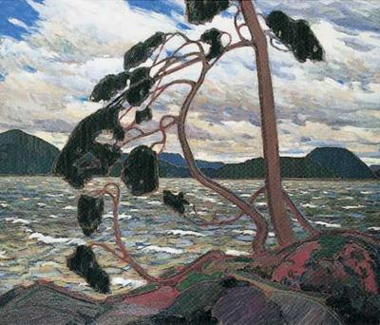
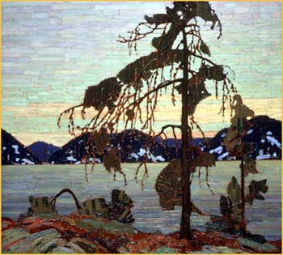
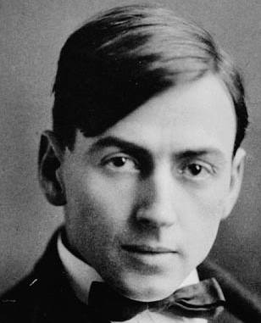
Tom Thomson
1877-1917
Not a member…but was included
in this circle of friends.
He was important to the other
artists, because he was an
outdoorsman and awakened
their interest in painting the
rugged northern Ontario landscape.
During the spring of 1917, tragedy struck the group as Tom Thomson drowned in Algonquin Park's Canoe Lake. This tragedy shocked the Group, and questions were raised about the suspicious circumstances surrounding the drowning
Notes:
During the spring of 1917, tragedy struck the group as Tom Thomson drowned in Algonquin Park's Canoe Lake. This tragedy shocked the Group, and questions were raised about the suspicious circumstances surrounding the drowning
-NOTE: Tom Thomson therefore was never really a member of the Group of Seven.

Slide 27
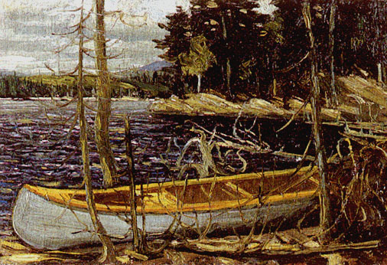
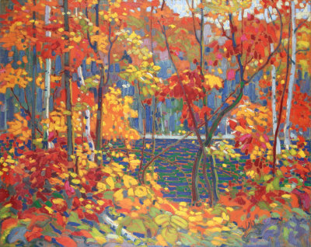
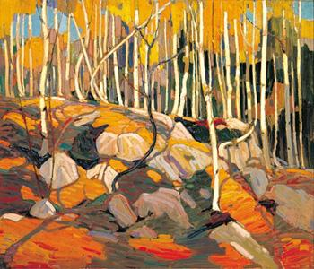
Canoe
The Pool
The Birch Grove 1915-1916
Notes:
More work done by Tom Thomson
QUESTION: by looking at his work, how is it distinctively Canadian?
How does his work look like the Group of Seven?
-How is his work different from the Group of Seven

Slide 28
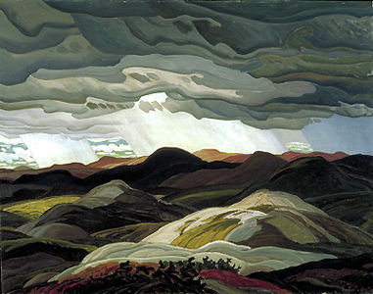
The Group were not
exclusively landscape
painters, and it was only after their first exhibition at the Art Gallery of Toronto
in 1920 that they began to identify themselves as
The Group of Seven
They were initially drawn together by a common sense of frustration with the conservative and imitative quality of most Canadian art.

Slide 29
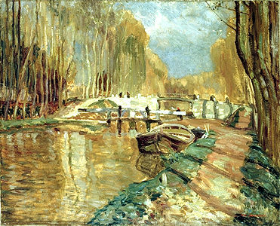
The Group of Seven
tried to show the
Relationship between
art and nature
They shifted away from imitation of natural effects,
towards the expression of their feelings for their subjects
What type of emotions and feelings
does this painting convey?
Notes:
The Group of Seven: Actually LOOKED at Nature to Create art.
QUESTION: What type of emotions and feelings does this painting convey?
-talk about light, dark
-how does this painting make you feel?
-can you see how there is a relationship between art and nature? How so? With some examples.
-Is this a naturalistic imitation of nature? Or does it express the artists feelings about nature?
-What do you think the artist was feeling at the time he was painting this?
-Describe the scene…is is a happy day? (sun shining, blue sky)
-do you think this is a real place? Why do you think that?

Slide 30
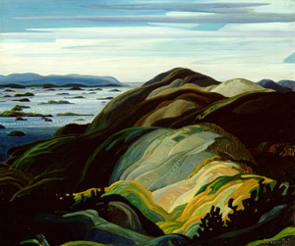
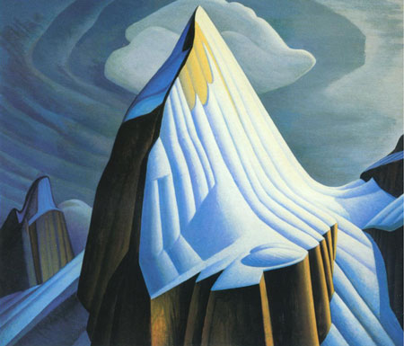
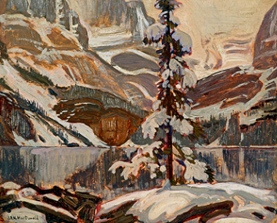
Group established itself as
uniquely Canadian in style
Notes:
During the 1920s, the group established itself as uniquely Canadian in style.
As their popularity grew, the group began travelling across Canada, a task not taken to lightly in those early days.
They are historically recognized as the first group of European descent to capture the feel of the Arctic on canvas.
-What does it mean to have a uniquely Canadian style??
-discuss the characteristics

Slide 31
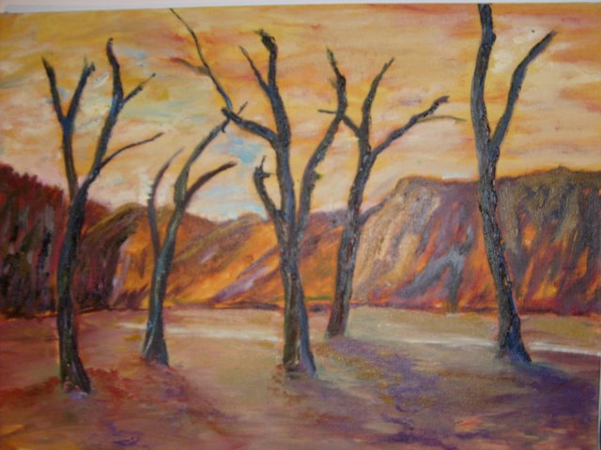
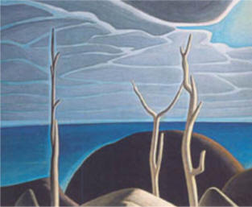
Which painting was done by a Group of Seven member?
Notes:
Discuss what the characteristics of the style of the Group of Seven.
RIGHT IMAGE: by Lawren Harris
LEFT IMAGE: grad student influenced by Group of Seven.
-colour, blending, shapes of the trees, naturalistic, shapes, ‘view of nature’
-evoke feeling and expression

Slide 32
Which painting was done by a Group of Seven member?
Notes:
LEFT: by Lawren Harris
RIGHT: Pastel drawing from a Grade 9 student.

Slide 33
Emily Carr
Kispiox Village
1929

Slide 34
Emily Carr
1871-1945
One of Canada’s most famous painters. Her inspiration was from looking at Native villages of her home province (British Columbia)
She was 57 when she became famous, and was mentored by Lawren Harris and painted with the Group of Seven
Carr was 57 years old before her paintings gained national
critical attention, and it was in the years that followed that
she created the body of work on which her reputation rests.
In 1937 Carr suffered a first and severe heart attack,
which marked the beginning of a decline in her health and
a lessening of the energy required for painting
Notes:
-Carr studied art in San Francisco and England and visited France in 1910-11, but it was in the remote native Indian villages of her home province that she found creative inspiration.

Slide 35
Emily Carr
Tree in Autumn
Totem Walk at Sitka
Notes:
-painted the skies, forests and Native Indian cultures of the Pacific Northwest in a style noted for its intense energy and shimmering light.
-The 2 main themes of her work, native and nature
--Their paintings of the rugged landscape of northern Canada impressed her mightily, as did their avowed intention to produce a distinctly Canadian art.

Slide 36
Emily Carr
Autumn Woods
Notes:
QUESTION: by looking at her work, how is it distinctively Canadian?
How does her work look like the Group of Seven?
-How is her work different from the Group of Seven

Slide 37
Possible Activities:
Students do additional research on one member of the Group of Seven, or Tom Thomson or Emily Carr
Students choose one image from that artist and re-create it using Pastels
Objective is to try to mimic the same colour theory as the original
Key ideas are: blending techniques, colour transitions, texture, and drawing accuracy.

