Slide 1
Introduction to Aquaculture
(Chapter 1)
Non-graded Quiz #1

Slide 2
Introduction to Aquaculture
(Chapter 1)
Common Definitions
Aquaculture
the farming of aquatic organisms (plants or animals)
Fish culture (farming)
culture of aquatic animals (plants excluded)
Seafood
animal and plant products from freshwater or seawater environments
Finfish
fishes
Shellfish
aquatic invertebrates with a “shell” (molluscs, crustaceans, sea urchins, etc.)

Slide 3
Introduction to Aquaculture
What is the difference between:
Aquaculture production and Fisheries production (or Capture fisheries)?
Aquaculture production implies:
Human intervention to enhance captive stock
Individual/Cooperative ownership of stock
Fisheries production implies:
Human intervention to manage and maintain fished stocks at natural production levels
Public ownership of stock

Slide 4
Introduction to Aquaculture
Capture Fisheries
Hunting-gathering activity
Variable recruitment and unpredictable stock size
Uncertain sustainable level of exploitation
Difficult to regulate so as to maintain stock sizes
Relatively low productivity
Many of world’s major capture fisheries range from heavily exploited to heavily overexploited
Capture Fisheries versus Aquaculture
Mean yearly productivity increase in decade of 1990’s less than 1% for capture fisheries compared to 10% for aquaculture (Fig. 1.1)
In China, aquaculture production volume has already surpassed capture fisheries production
There is current trend to use aquaculture production for stock enhancement of wild populations, providing link between aquaculture and fisheries (although similar links have existed before)

Slide 5
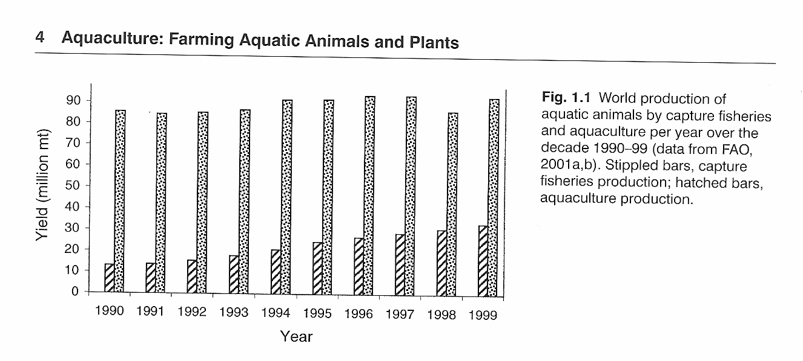
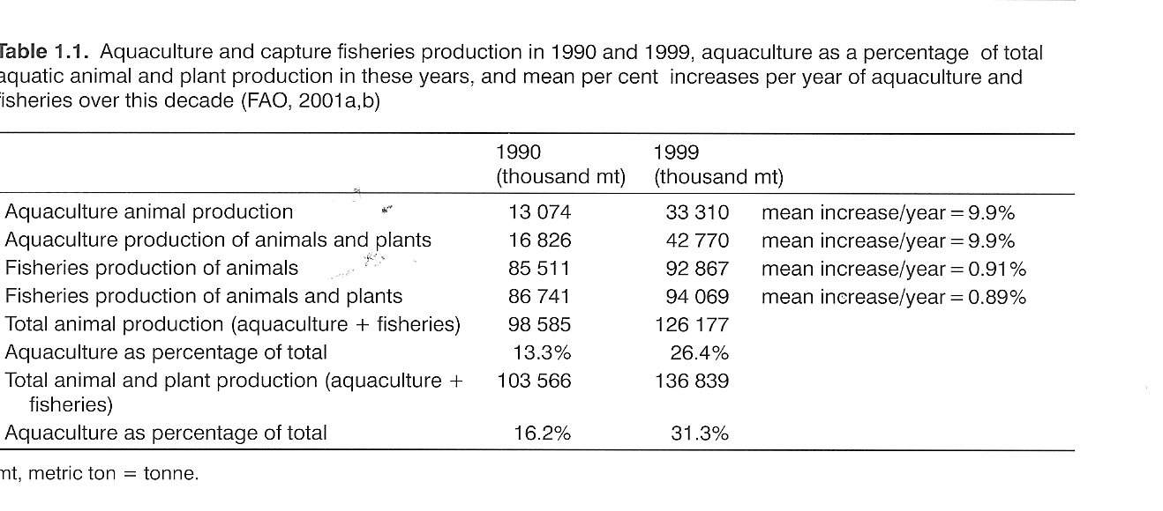
Updated Worldwide Production Volumes (excluding plants)
2004
Aquaculture: 45.5 million mt
Capture fisheries: 95 million mt
Reference: Food and Agriculture Organization of the United Nations. 2007. The State of the World Fisheries and Aquaculture – 2006.
2006 (see next slide for reference)
Aquaculture: 51.6 million mt
Capture fisheries: 92.0 million mt
Worldwide animal aquaculture as percent of total animal production volume (capture fisheries + aquaculture)
1990: 13.3%
1999 : 26.4%
2004: 32.4%
2006: 36.0%

Slide 6
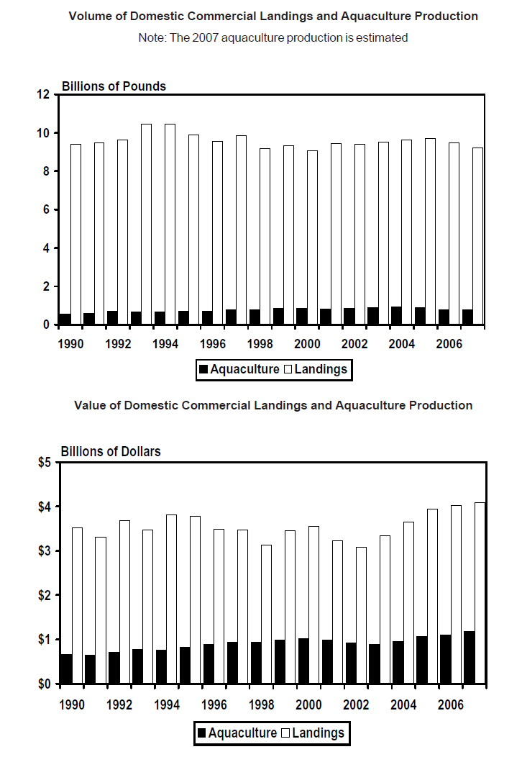
Unlike worldwide values, total and relative fish production from capture fisheries and aquaculture has remained relatively steady in the United States over the last years.
(Note: 1 metric ton = 2205 pounds)
2006 Production in USA (excluding plants)
Aquaculture: 0.47 million mt
Capture fisheries: 4.86 million mt
2006 aquaculture production as percent of total volume: 8.7%
(compared to 36% worldwide and 66.8% in China; see previous slide and reference below)
*Reference for all notes on this slide: NOAA Fisheries. 2008. Fisheries of the United States - 2007. Current Fishery Statistics No. 2007.
In 2006 and 2007, total fish production value in the USA was estimated at a little over $5 billion per year.

Slide 7
Introduction to Aquaculture
Origins of Aquaculture
Agriculture first practiced in the Middle East about 10,000 years ago (wheat and barley).
Aquaculture developed thousands of years later in China, about 3500 BC. Common carp may have been first fish species cultured. First aquaculture text written in China about 500 BC (Fan Lei).
Oysters were farmed in Japan about 2,000 BC.
Aquaculture in Africa, Americas and Australia started only within the last several hundred years.
Reason for late development of aquaculture compared to terrestrial agriculture:
interactions between environment and aquatic organisms are not as well understood as those between environment and terrestrial organisms.

Slide 8
Introduction to Aquaculture
Fish Culture in the U.S.
1853 - first artificial fertilization of brook trout eggs in Ohio
1870 - American Fish Culturists’ Association was founded - predecessor of American Fisheries Society, the country's oldest natural resource conservation organization
1871 - US Fish and Fisheries Commission - predecessor of US Fish and Wildlife Service, was established by U.S. Congress. In addition to studies of the natural history of fishes, the Commission also started what is now known as the National Fish Hatchery System (Baird Hatchery in California was first). Most controversial “success” story: the introduction of common carp in national waters in the late 1800’s
For brief U.S. history, see http://www.nefsc.noaa.gov/history/

Slide 9
Introduction to Aquaculture
Main groups of cultured species worldwide (Figs 1.2-1.3)
Fishes (freshwater and marine species)
Mollusks (bivalve and gastropod)
Crustaceans (decapods)
Algae (macro- and micro-algae)
Cyprinid fishes (carps) and macro-algae dominate world aquaculture production, but many other species are also target of aquaculture - in China, some 110 species of aquatic animals and plants are cultured
shellfish

Slide 10
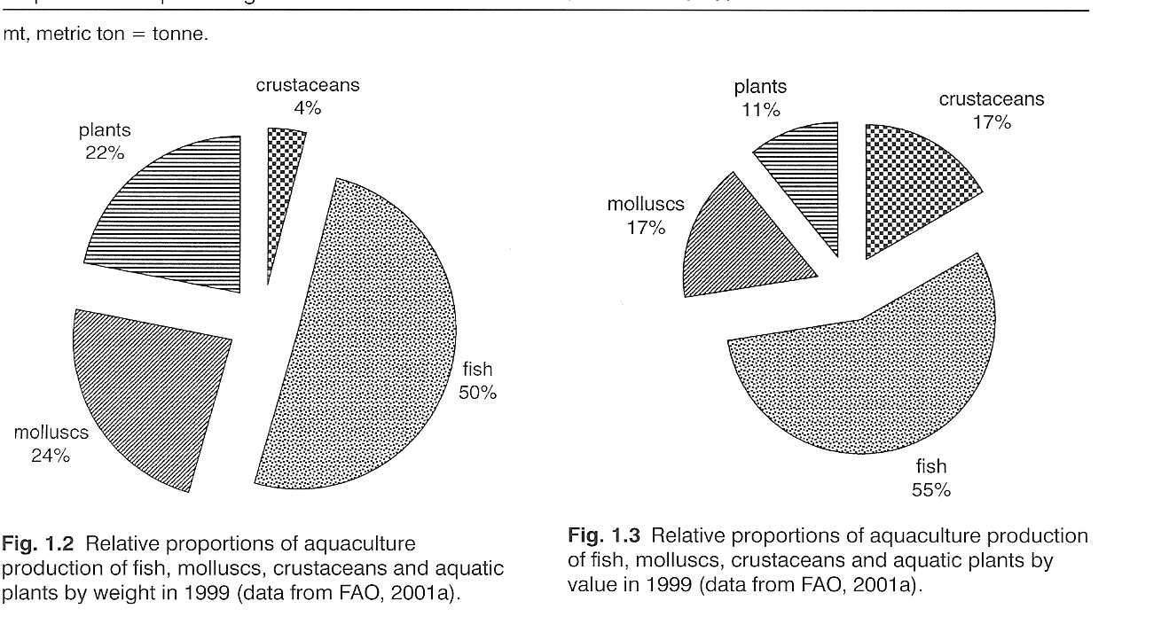
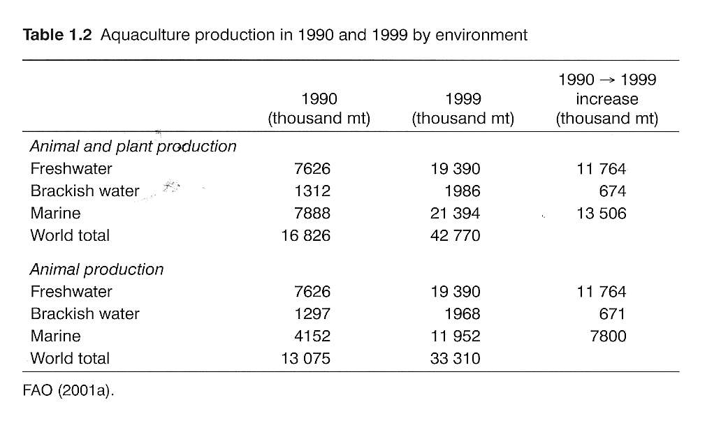

Slide 11
Introduction to Aquaculture
Fishes
Domesticated species (breeding based on genetically selected broodstock):
Common carp
Atlantic salmon
Rainbow trout
Tilapias
Channel catfish
“Wild” species
All others

Slide 12
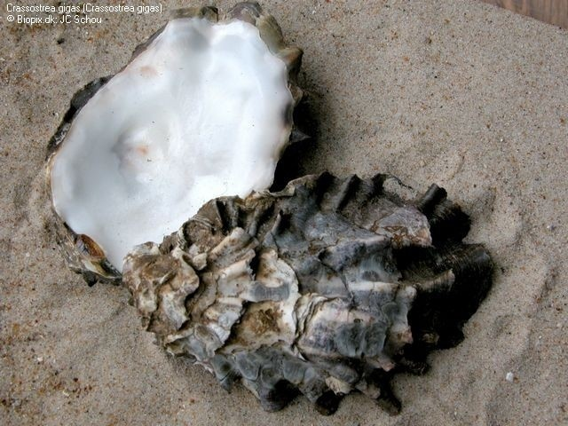
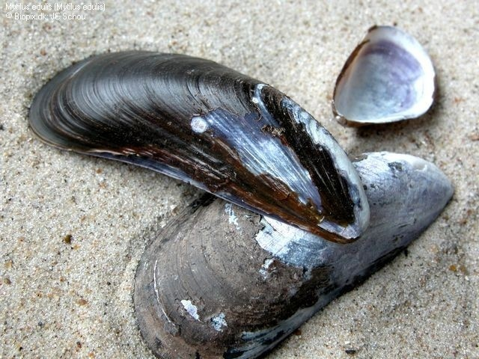
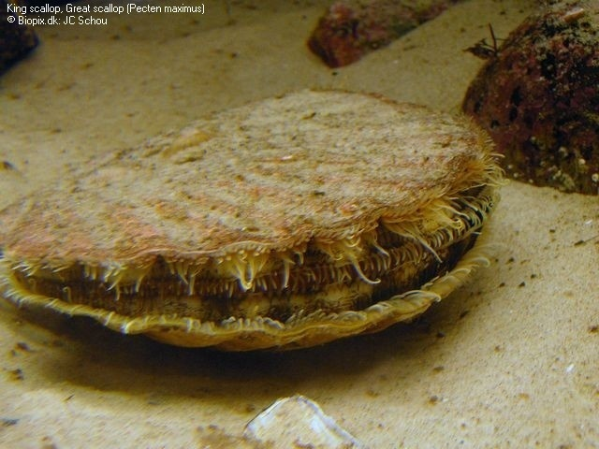
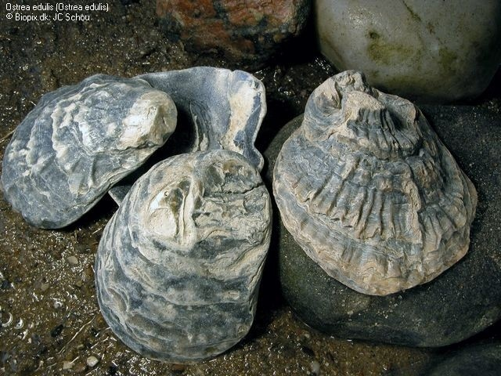
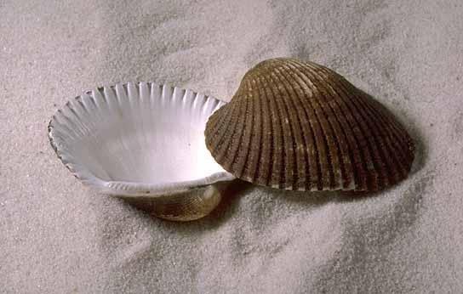
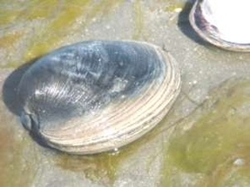
Introduction to Aquaculture
Mollusks - bivalve
Table oysters (primarily Pacific oyster; also European flat oyster)
Table mussels (marine)
Scallops
Cockles (e.g., Blood Ark) and clams (e.g., Northern quahog)
Pearl oysters and pearl (freshwater) mussels

Slide 13
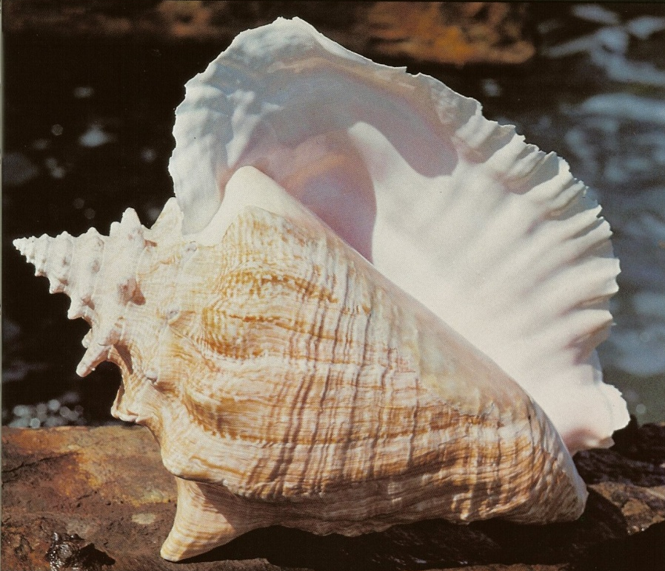
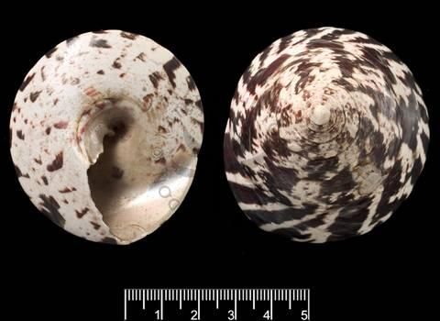
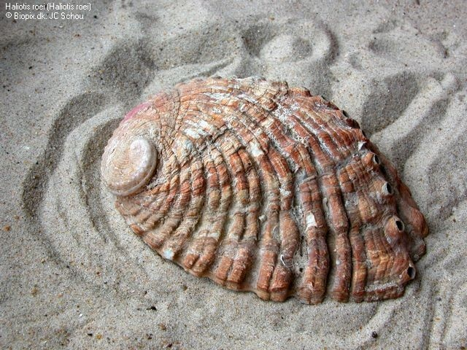
Introduction to Aquaculture
Mollusks - gastropods
Abalone (Haliotis spp.)
Trochus (top shell)
Queen conch (Strombus gigas)

Slide 14
Introduction to Aquaculture
Crustaceans
Marine shrimps (12 species of family Penaeidea)
Black tiger shrimp (Asia and Australia)
Pacific white shrimp (Americas)
Freshwater crustaceans
Mitten crabs (China)
Freshwater crayfish (crawfish) - 12 species
Freshwater prawns - several species but primarily Macrobrachium rosenbergii (Giant Malaysian prawn)

Slide 15
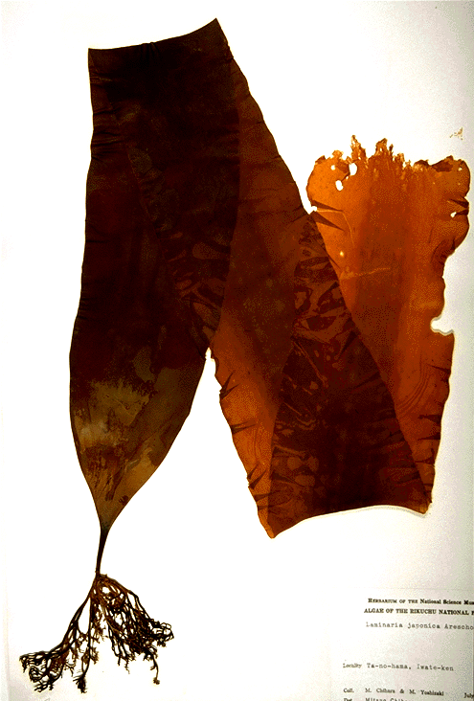
Introduction to Aquaculture
Algae
Macro-algae (seaweeds - cultured for hundreds of years)
Brown seaweeds (Phaeophyta; e.g., Japanese kelp)
Red seaweeds (Rhodophyta)
Green seaweeds (Chlorophyta)
Micro-algae (diverse taxonomy - cultured for last 2-3 decades)
Sources of high-value, fine chemicals (carotenoid, fatty acids)
Wastewater treatment
Soil conditioners for agriculture
Biofuel production

Slide 16
Introduction to Aquaculture
Main aquaculture species in the U.S.A.
Top three by volume in 2006
Channel catfish (by far dominant species)
Crawfish
Rainbow trout
Top three by value in 2006
Channel catfish (by far dominant species)
Crawfish
Oysters

Slide 17
Introduction to Aquaculture
Picture credits
Oysters, mussels, scallop, abalone: J.C. Schou, Biopix.dk
Hard clam: Randy Newman, FAO
Blood Ark: K.B. Sandved, National Wildlife Federation
Queen conch: Turgeon et al. (1988). American Fisheries Society Special Publication 16.
Trochus: The Natural History Museum, UK.
Japanese kelp: http://research.kahaku.go.jp/botany/seaweeds/BrownAlgae/makonbu.html
(These pictures are used for classroom teaching purposes only)

