Slide 1
Planet Earth
Social Studies 8

Slide 2
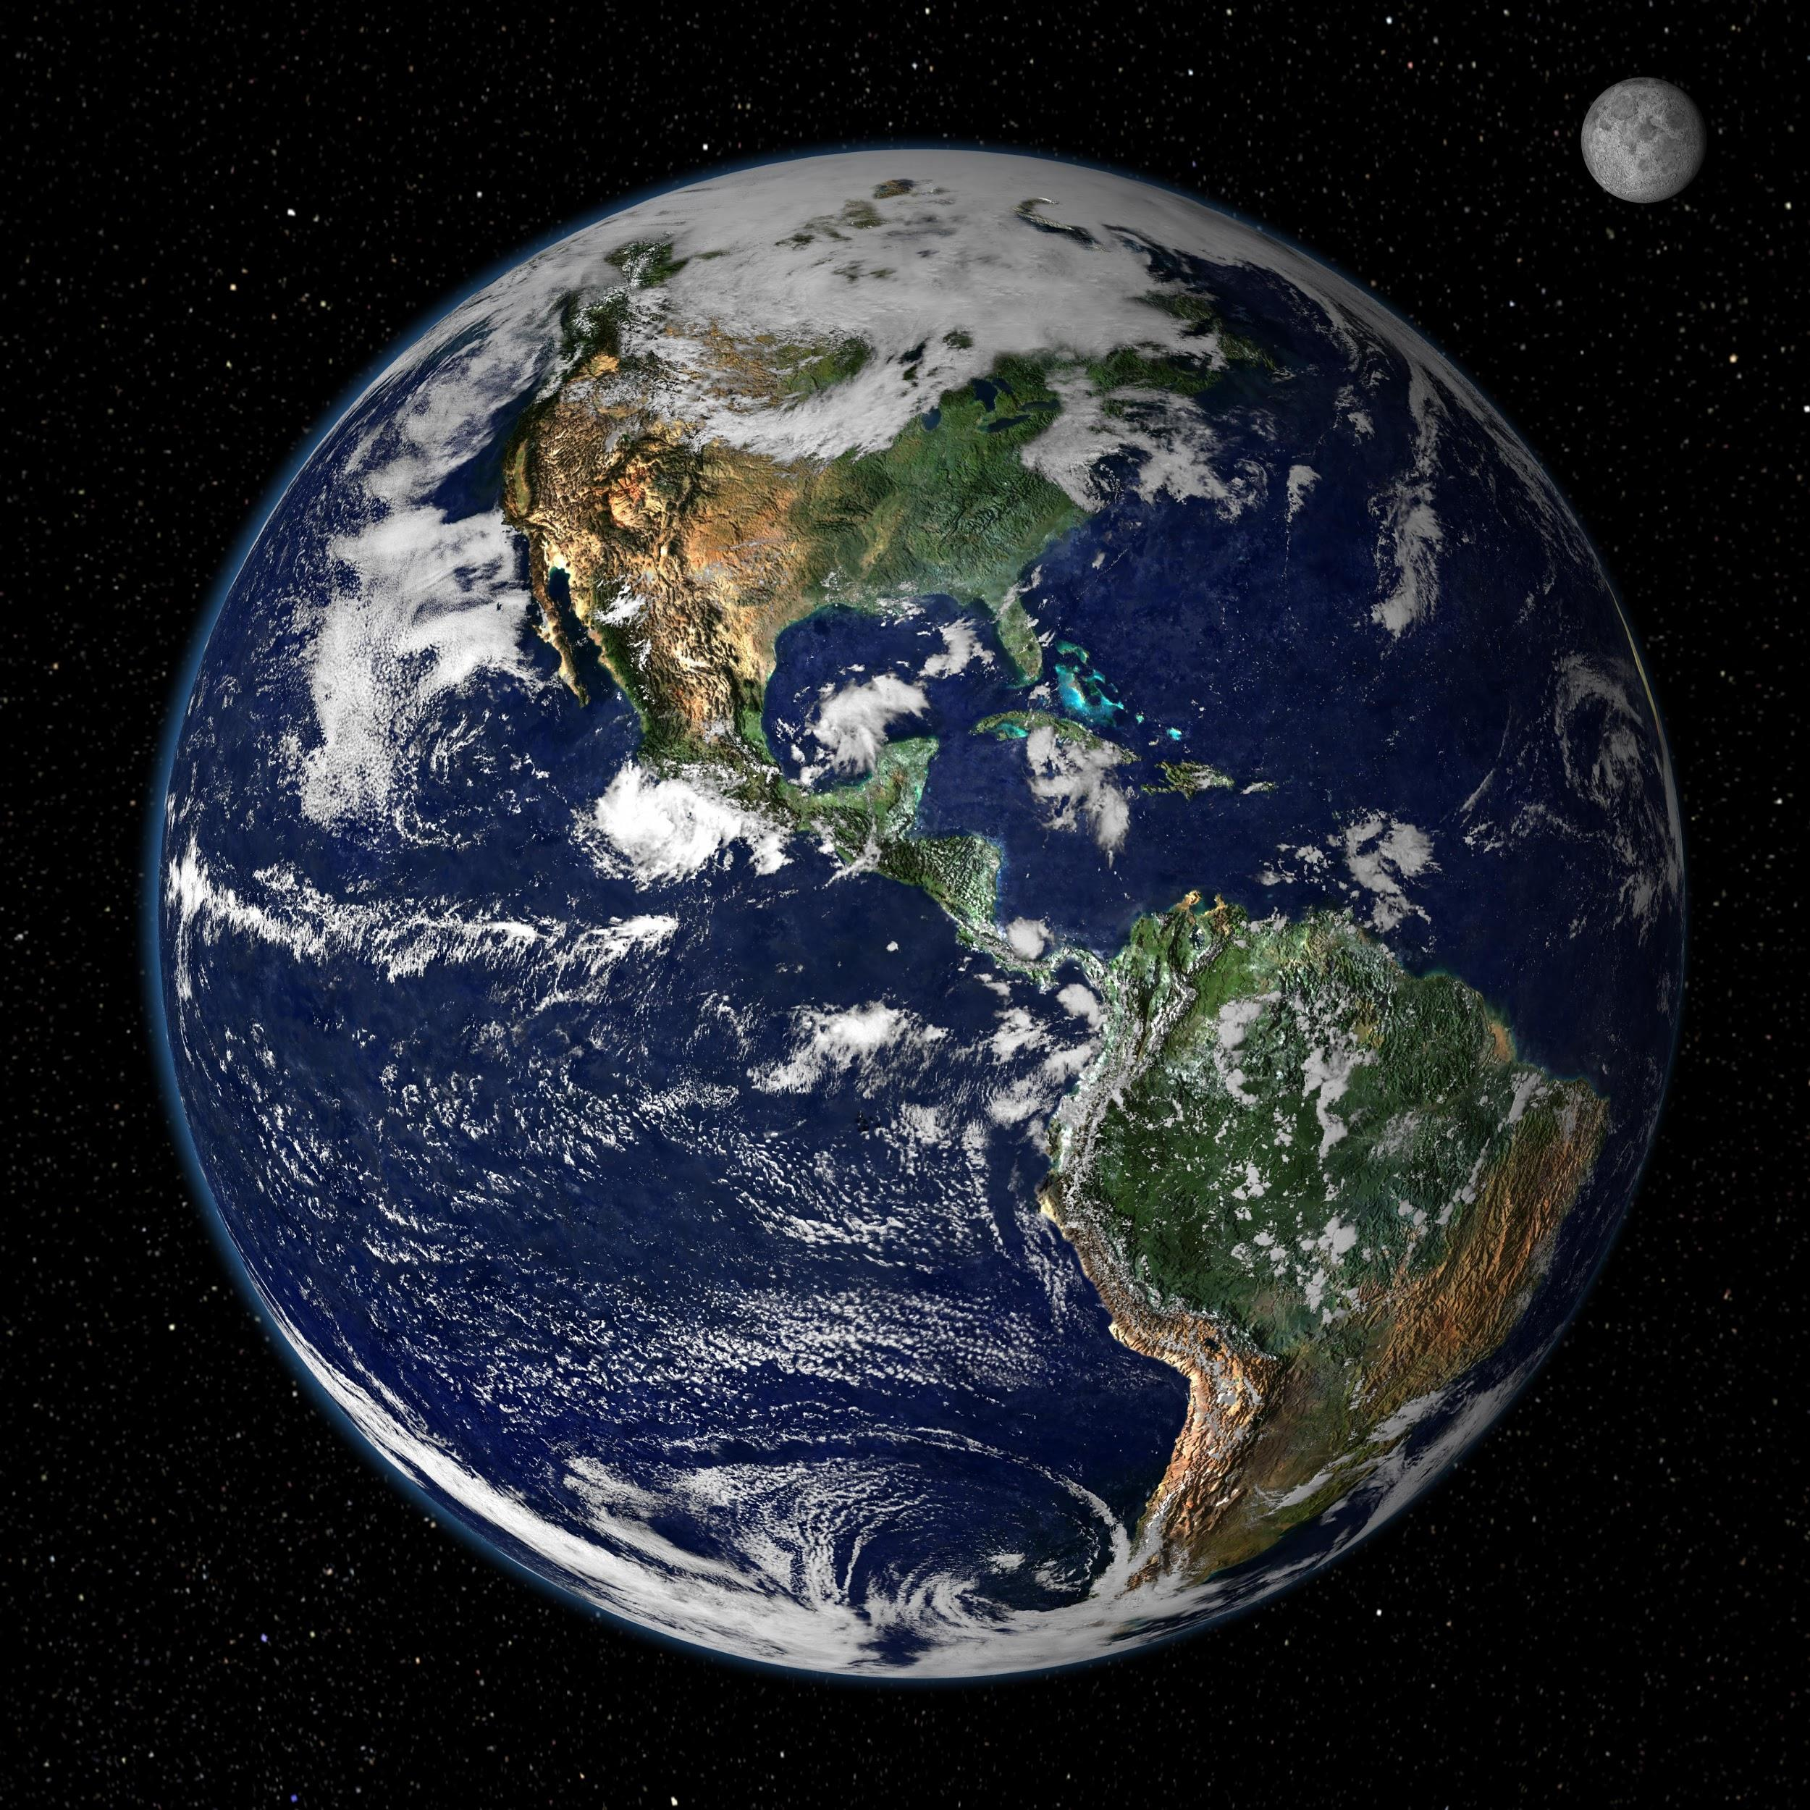
Planet Earth
The earth is made up of a great variety of rock all with different ages
Canada is home to some of the oldest rocks at about 4 billion years old

Slide 3
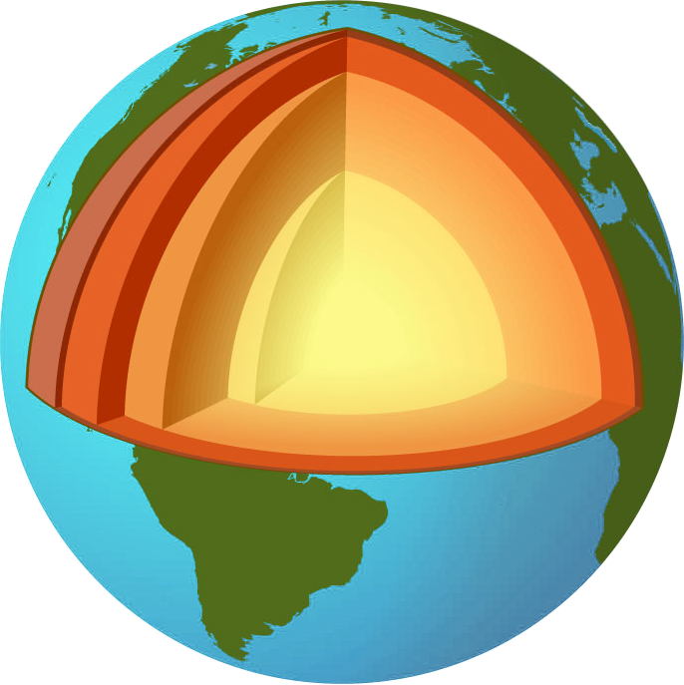
Layers of the Earth
Scientists believe the earth formed in layers with the more dense materials settling to form the core.
The lighter layers including gases formed the outer layers.

Slide 4
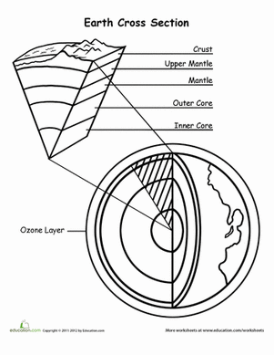
Layers of the Earth
Crust: surface layer, thinest layer, solid
Mantle: middle layer, thickest layer, made up of liquid rock called magma
Core:
Outer core: liquid
Inner core: solid inner core, very hot because of pressure.

