Slide 1
What is Sustainable Agriculture?
“…a journey, not a destination”
Iowa Farmer

Slide 2
Sustainable Agriculture
“…an integrated system of plant and animal production practices…that will
satisfy human food and fiber needs
enhance environmental quality
make the most efficient use of
nonrenewable resources
sustain economic viability
enhance quality of life.”
1990 Farm Bill

Slide 3
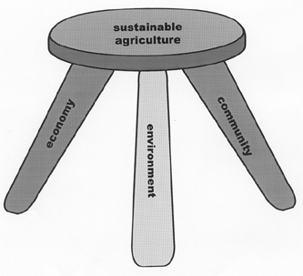
The three-legged stool of sustainability

Slide 4
Economically sustainable
Provides a secure living for farm families
Provides a secure living to other workers in the food system
Provides access to good food for all

Slide 5
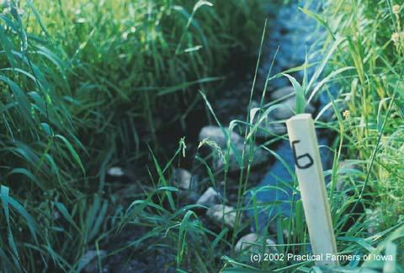
Environmentally Sound
Preserves
the
quality of
soil,
water,
and air

Slide 6
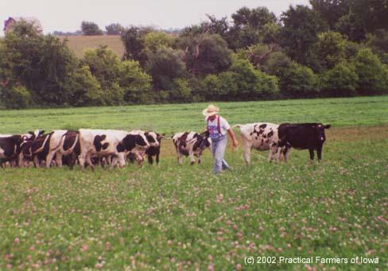
Environmentally Sound
Cooperates
with and
is modeled
on natural
systems

Slide 7
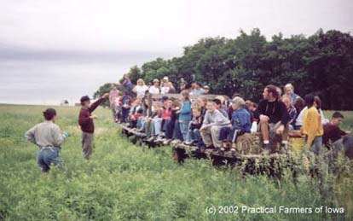
Socially sustainable
Good for families
Supports communities
Fair to all involved

Slide 8
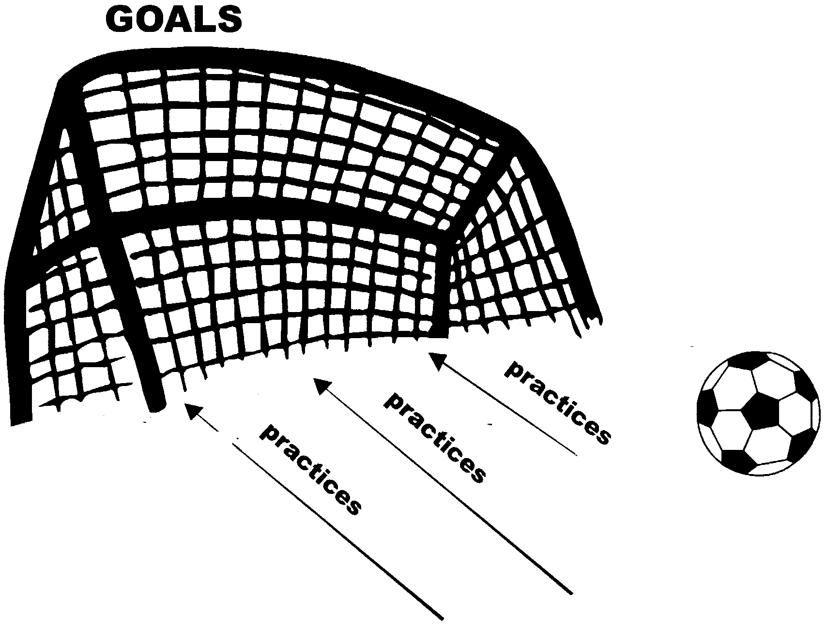
Goals: A desired end
Practices: Actions to achieve a goal

Slide 9
How do you get to goals?
Figure out where you are
Analyze your strengths and weaknesses
Select strategies (practices)
Keep monitoring your progress
Re-evaluate your goals and plans

Slide 10
Where are we?
What are the
Strengths
and
Weaknesses
of our current agricultural system?

Slide 11
Successes
abundant food supply in the developed world
fresh fruits and vegetables available year-round
cheap food
luxury foods such as coffee, tea, chocolate, and spices easily available around the world
effective food preservation technologies (refrigeration, freezing, canning, packaging)
convenience foods
mechanization produces high labor efficiency
improvements in soil conservation
availability of agricultural inputs for quick solutions to production problems

Slide 12
Problems
continuing soil loss
food safety concerns (mad cow disease, food poisoning outbreaks, antibiotic resistance, toxins and pesticides)
water pollution, air pollution (& odors), habitat loss, water depletion
continuing hunger – and rise of obesity
failing farms, economic uncertainty and stress
declining communities
farm accidents, chronic diseases linked to agricultural chemicals
reliance on fossil fuels, global warming
farmland loss to development, ugly countryside
difficulty of starting in farming

Slide 13
Conclusion
Agriculture has accomplished much
There are still many problems to solve, both old and new
Sustainable agriculture is about trying to solve these problems – without creating new ones.

