Slide 1
The Green Revolution
Agriculture 11

Slide 2
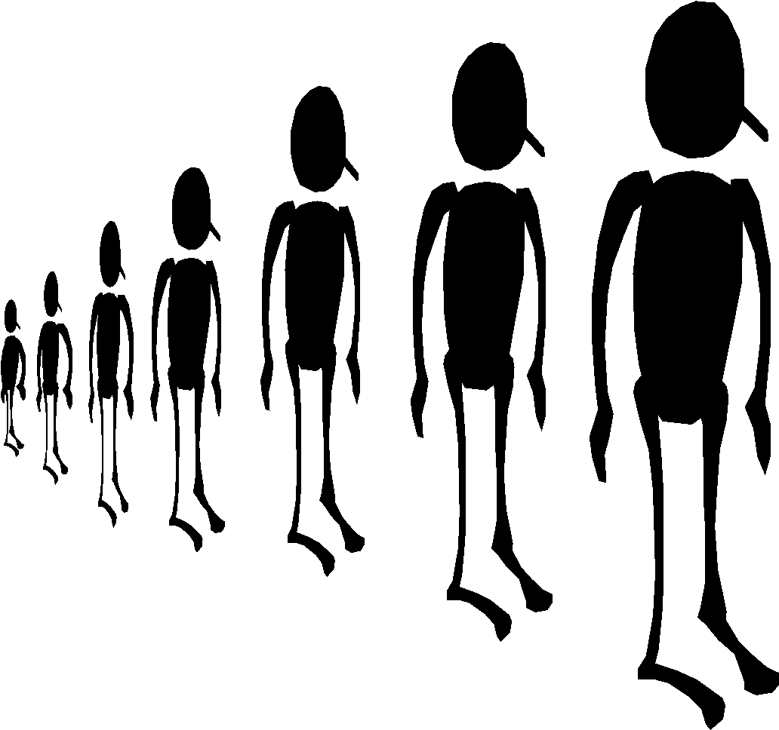
The Problem
Increasing Population 6.5 billion people, decrease in farmland
We can’t feed everyone on Earth with traditional agriculture.

Slide 3
The numbers
Approximately 80% of the world’s population get only 20% of the food.
Approximately 20% of the world’s population gets 80% of the food.
Can you guess where YOU are?

Slide 4
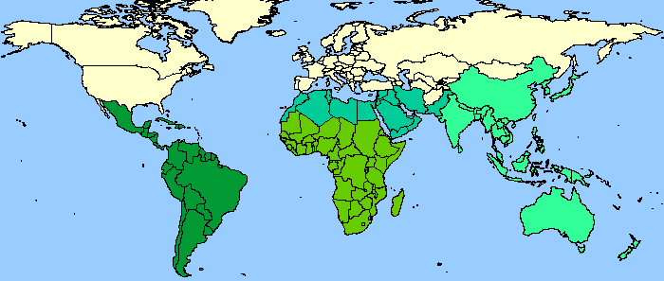
Population
http://wparks.myweb.uga.edu/ppt/green/sld039.htm

Slide 5
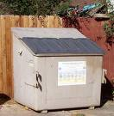
Put it in perspective
Do you throw food away because it has gone bad?
Do you refuse food because you don’t like it?
Do you have a dime in your pocket? If you do, you are richer than most of the people on our planet.

Slide 6
What is the solution?
There isn’t one that’s perfect
BUT
There is one that has made a difference in some places.

Slide 7
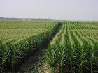
The GREEN REVOLUTION
A change in agriculture
Led to large increases in production
1940s-1960s

Slide 8
The Big Idea
Help food production keep up with population growth.

Slide 9
History
Began in Mexico in 1943.

Slide 10
Purpose
To develop high yield wheat and corn varieties
Norman Borlaug won the Nobel Prize in 1970 for his work on wheat breeding.

Slide 11
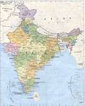
INDIA
Began a program of plant breeding, irrigation, development and financing of agrichemicals.
By late 1970s, rice yields were up 30% and a famine was avoided.

Slide 12
How was it done?
Using new machines
Fertilizers
Pesticides
Irrigation
http://wparks.myweb.uga.edu/ppt/green/sld056.htm

Slide 13
Food production has advanced and we can get food cheaper than at any point in history. The total food available per person worldwide has increased exponentially. There is enough grain alone being currently produced to get everyone on earth 3,500 calories a day, which is enough to make most people fat (Lappe, 1998).

Slide 14
Yet hunger persists at alarming rates, and if you discount China from the equation, world hunger has actually increased by 11 percent since the start of the revolution.

Slide 15
Not only did the Green Revolution completely bypass the real issues of hunger: the concentration of wealth in economic power in the hands of very few people, the last 50 years of this new style of agriculture has led to some devastating effects.

Slide 16
Brainstorm
What could some drawbacks of the green revolution be?
Discuss at your tables – try to think of 3

Slide 17
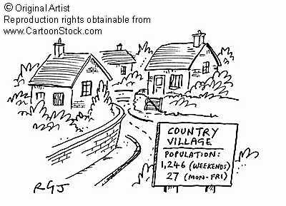
What problems have been caused by the Green Revolution?
An increase in rural to urban migration

Slide 18
Rural Poverty

Slide 19
The fertilisers and machinery was often too expensive for farmers

Slide 20
Many people were made unemployed by the introduction of machinery

Slide 21
Sources
sitemaker.umich.edu/section7group1/introduction
http://wparks.myweb.uga.edu/ppt/green/sld037.htm

