Slide 1
Introduction to AgriScience & Technology

Slide 2
Human Food Needs
Energy
Growth and Repair
Good Health
Body Processes

Slide 3
Sources of Food
Fruits
Apples
Flowers
Cauliflower
Stems
Celery
Multiple Parts
Turnip (leaves and roots)
Plants
250,000 plants on earth
600 are used for food
Leaves
Lettuce
Seeds
Beans
Roots
Potatoes

Slide 4
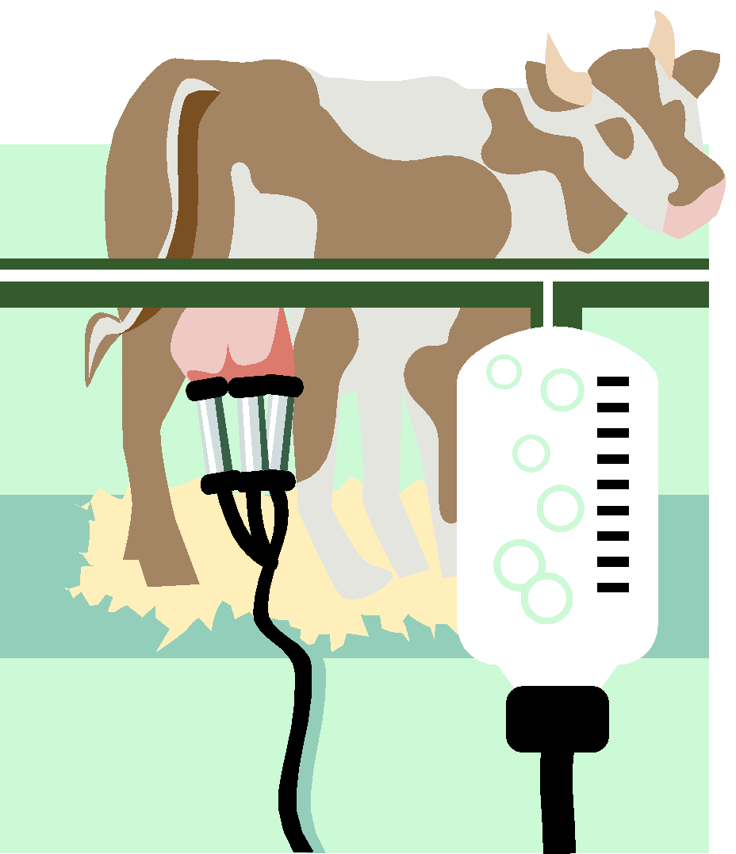
Animal Sources
Terrestrial
Animals that live on land
Aquatic
Animals that live in water
Meat
Eggs
Milk

Slide 5
Fiber (Clothing)
Animal Fibers
Wool
Fur
Silk
Plant Fibers
Cotton
Flax
Hemp
Jute
Sisal
Synthetics
Those made by man

Slide 6
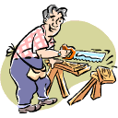
Wood Products
Lumber
Plywood
Veneer
Composition Board
Paper

Slide 7
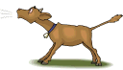
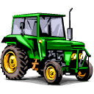
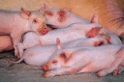
Definition of Agriculture
Agriculture
The science of growing crops and raising livestock.

Slide 8
Innovations in Agriculture
Charles Townshed
1st crop rotation system
Jethro Tull
Developed seed planting machine in early 1700’s.
Eli Whitney
Cotton gin
Cyrus McCormick
Patented a harvesting machine (reaper) in 1834

Slide 9
John Deere
1837 1st steel moldboard plow
Gregor Mendel
Austrian botanist
Discovered basic principles of heredity
Silver Bullet Era
1940’s-1950’s
New pesticides on market
Dramatically increases yields.
Biotechnology Era
1984 entered stock market
1995 RoundUp Ready Soybeans

Slide 10
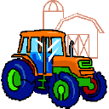
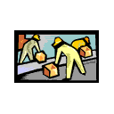
Areas of Agriculture
Supplies and Services
Machinery and equipment
Seed
Chemicals
Feed and animal medicines
Production Agriculture
Marketing and Processing

Slide 11
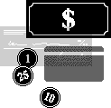
Impact of Agriculture
1.6% Involved in production ag.
15-17% work in the agricultural industry

